Slide 1
CHAPTER 3
DERIVATIVES

Slide 2
CONTENTS
3.1. Derivatives
3.2. Derivative as a Function
3.3. Differentiation Formulae
3.4. Rates of Change in the Natural and Social Sciences
3.5. Derivatives of Trigonometric Functions
3.6. The Chain Rule
3.7. Implicit Differentiation
3.8. Derivatives of Logarithmic Functions
3.9. Related Rates
3.10. Linear Approximations and Differentials

Slide 3
3.10. LINEAR APPROXIMATIONS & DIFFERENTIALS
3.10.1 Linear Approximations
3.10.2 Applications to Physics
3.10.3 Differentials

Slide 4
3.10.1 Linear Approximations
Recall that the tangent at (a, f(a)) is an approximation for the curve y=f(x).
So we have the linear approximation of f at a
f(x) ≈ f(a) + f ‘(a)(x - a)
The linear function
L(x) = f(a) + f ‘(a)(x - a)
is called the linearization of f at a

Slide 5
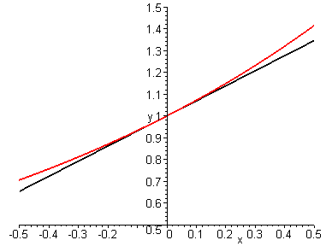
y=f(x)
y=L(x)
(a, f(a))

Slide 6
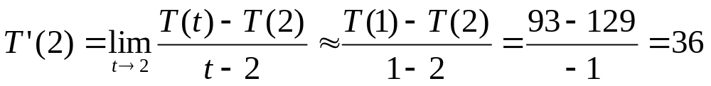
Example. The temperature of a turkey in an oven changes after every hour: from 50º to 93º then 129ºF. Predict the temperature of the turkey after 3 hours
Solution. Let T(t) be the temperature of the turkey after t hours. We first estimate T’(2) by
Therefore we have the linear approximation
So the predicted temperature is 165ºF

Slide 7
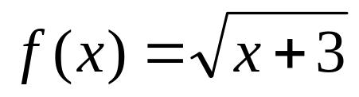
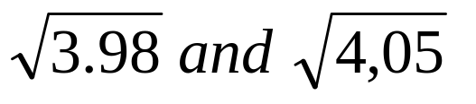
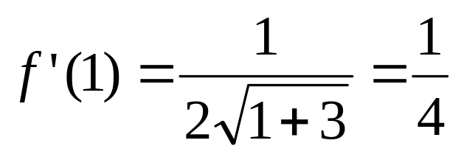
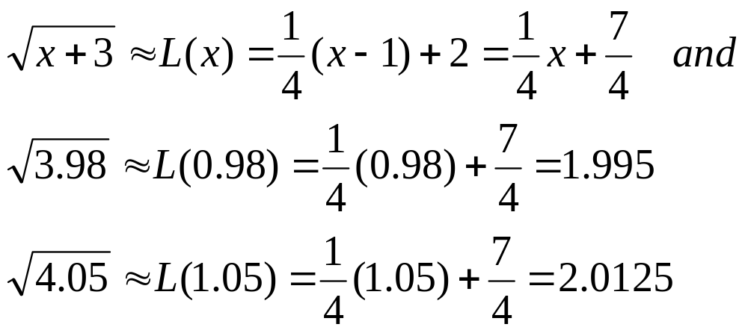
Example. Find the linear approximation for
at a=1. Use it to estimate
Solution. We have
So we have the linear approximation

Slide 8
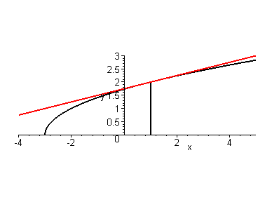

Slide 9
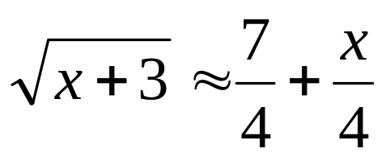
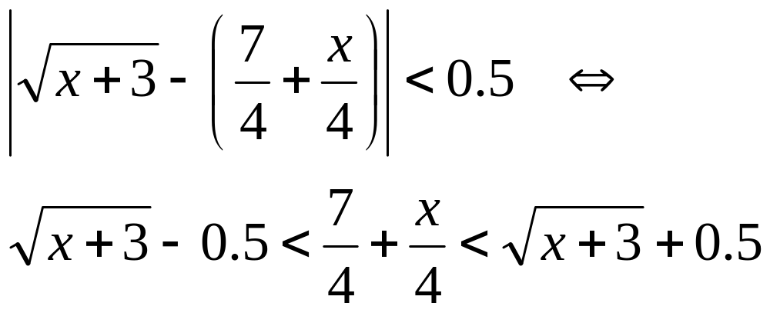
Example. For what values of x the linear approximation
is accurate to within 0.5 ? to within 0.1 ?
Solution. Accuracy to within 0.5 means
i.e. the linear approximation curve should lie between the curves obtained by shifting upward and downward of the given curve by an amount 0.5

Slide 10
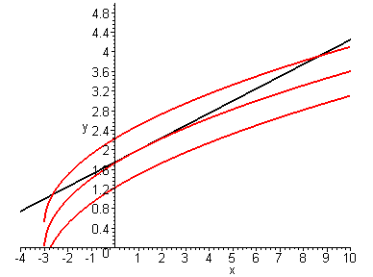
We see that x must be somewhere between –2.5 and 8
We will zoom in around these two points to read more accurate values of x

Slide 11
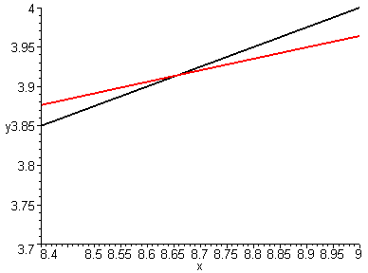
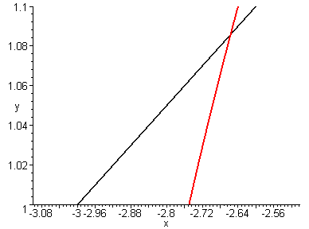
So to obtain the approximation with the accuracy to within 0.05 it is safe to take
-2.6 < x <8.6

Slide 12
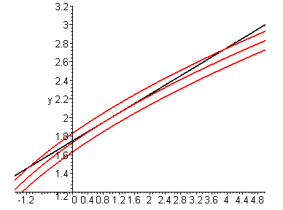
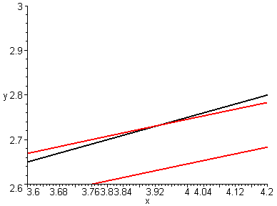
Similarly to obtain the approximation with the accuracy to within 0.1 it is safe to take
-1.1 < x <3.9

Slide 13
3.10.2. Applications to Physics
In Physics, a function is often replaced by its linear approximation to simplify the calculations
For instance the tangential acceleration of a pendulum is given by a_{T} = -gsinθ.
To obtain a formula for the period we can approximate sinθ by θ since the value of the derivative, cosθ at θ = 0 is 1.
Indeed for small θ, we have
sinθ ≈ sin 0 + (cos 0)θ = θ

Slide 14
The main force is the gravity P=mg, the tangent force is mg sinθ. Therefore the tangential acceleration is given by a_{T} = -gsinθ. For small θ, we have
sinθ ≈ sin 0 + (cos 0)θ = θ
θ
mgθ
mg

Slide 15
In paraxial optics we only consider light rays arriving at shallow angles θ relative to the optical axis.
Then both sinθ and cosθ are replaced by their linear approximations θ and 1 respectively:
sinθ ≈ sin 0 + (cos 0)θ = θ
cosθ ≈ cos 0 + (-sin 0)θ = 1

Slide 16
3.10.3 Differentials
Definition. If y=f(x) is a differentiable function then the differential dx is an independent variable, i.e. it can take any real value. The differential dy is a dependent variable defined in terms of dx by
dy = f '(x)dx
Notice that dy depends also on x.

Slide 17
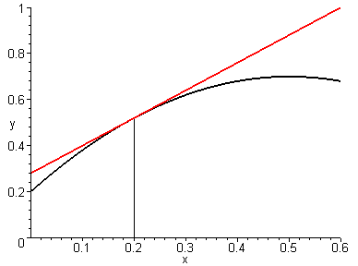
Q
R
Let dx = Δx, then the distance SQ is the change in y
Δy = f(x + dx) - f(x)
And the distance SR is
dy = f'(x)dx
dy
P
Δy
S
dx=Δx
x
x+Δx
Let dx = x – a then x = a + dx then we can rewrite the linear approximation in the form
f(x) ≈ f(a) + f ‘(a)(x - a) = f(a) + dy

Slide 18
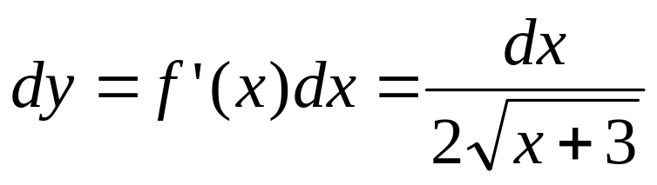
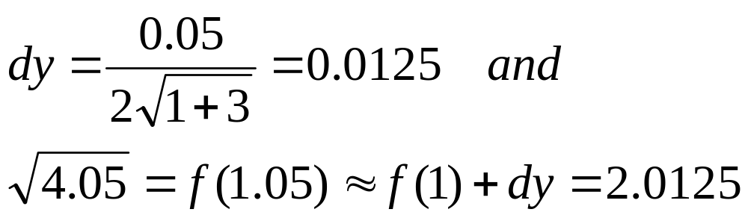
Example. For the function
We have
If a = 1 and dx = Δx =0.05 then

Slide 19
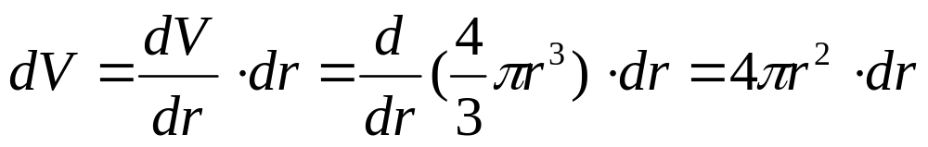
Example. The radius of a sphere is 21cm with a possible error of at most 0.05cm. What is the maximum error in using this to compute the volume of the sphere?
Solution. If the radius of the sphere is r with an error of dr = Δr, then the corresponding error in computing the volume V is ΔV which can be approximated by the differential
When r = 21 and dr = 0.05, this becomes
dV = 4π (21)²0.05 ≈ 227cm³

Slide 20
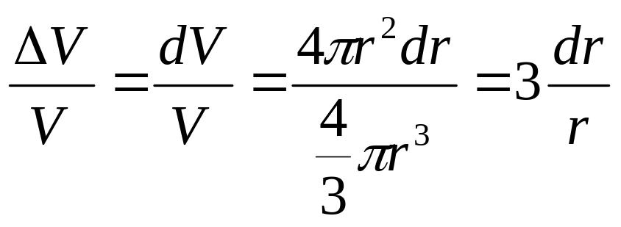
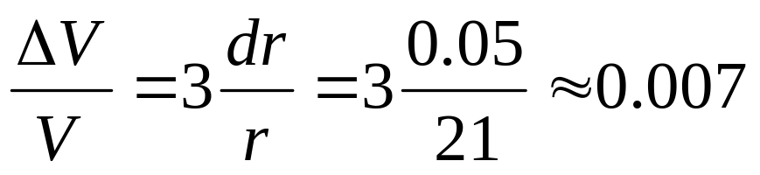
Note . This absolute error is rather large. However a better picture is the relative error which is defined by
When r = 21 and dr = 0.05, this becomes
i.e. the relative error is about 0.7% of the volume

